Slide 1
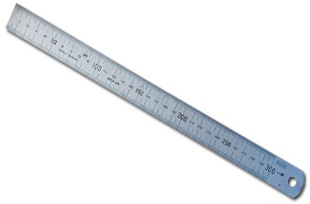

Basic Marking ,Cutting and Hand Tools.
1. Ruler
- It is used to measure short distances.
2. Measuring Tape
- It is used to measure shorter or longer distances.

Slide 2
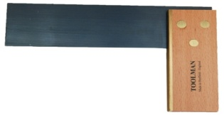
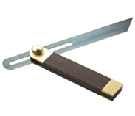
3. Try Square
- It is used for checking square. (internal & external right angles)
4. Bevel
- It is used to set a desired angle.

Slide 3
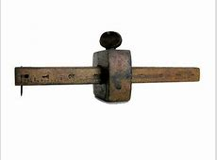
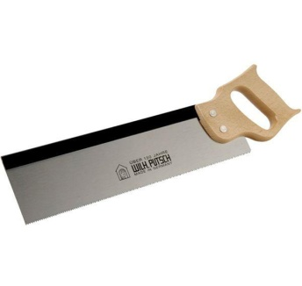
5. Marking Gauge
- It is used for drawing lines.
6. Tenon Saw
- It is used for cutting wood.

Slide 4
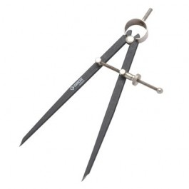

7. Divider
- It is used to draw circles, arcs, radii etc.
8. File
- It is used for finishing wood.

Slide 5
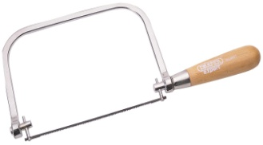

9. Coping Saw
- It is used to cut external shapes.
- It is used to cut interior cut-outs in woodworking.
10. Chisel
- It is used as a cutting tool in woodworking .

Slide 6
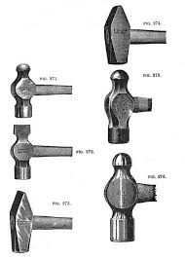
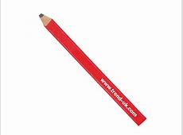
11. Hammer
- It is used for general hammering in the workshop.
12. Marking Pencil
- It is used for drawing Lines.

Slide 7
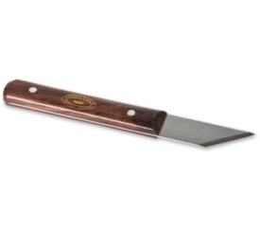
13. Marking Knife
- It is used for drawing lines and cutting in the workshop.
Demonstration Video :
-
Feedback : Activity

Slide 8
Kwa Thema Skills School
Subject : Maintenance Marks : 10
Grade : Year 2 Time : 30mins
Date :
Question:1
1. Name the following tools depicted below:
1.__________________ 2.______________________
3.___________________ 4. ______________________

Slide 9
5. _________________ 6. ____________________
7. __________________ 8. ___________________
9. __________________ 10. ___________________
(10)

